Slide 1
System and Network Administration
Firewalls &
Packet Filtering

Slide 2
Security Policy
Strict control over access to system configuration files
Control privileges
Users should only have access to the services that they have been specifically authorised to use and any access by remote users or connections to remote computer systems must be authenticated.
Encrypted communication channels
Close telnet and ftp ports – use ssh
Monitor system use and performance
Track reports of attacks and vulnerabilities
Test and evaluate failure modes
Avoid single point of failure

Slide 3
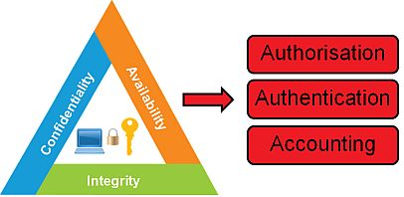
AAA
Firewalls provide a single block point, where security and auditing can be imposed.
Firewalls provide an important logging and auditing function, providing summaries to the Administrator about what type/volume of traffic has been processed through it.
This is an important benefit: Providing this block point can serve the same purpose on the network as an armed guard does for physical premises.
BUT – this creates a single point of failure!

Slide 4
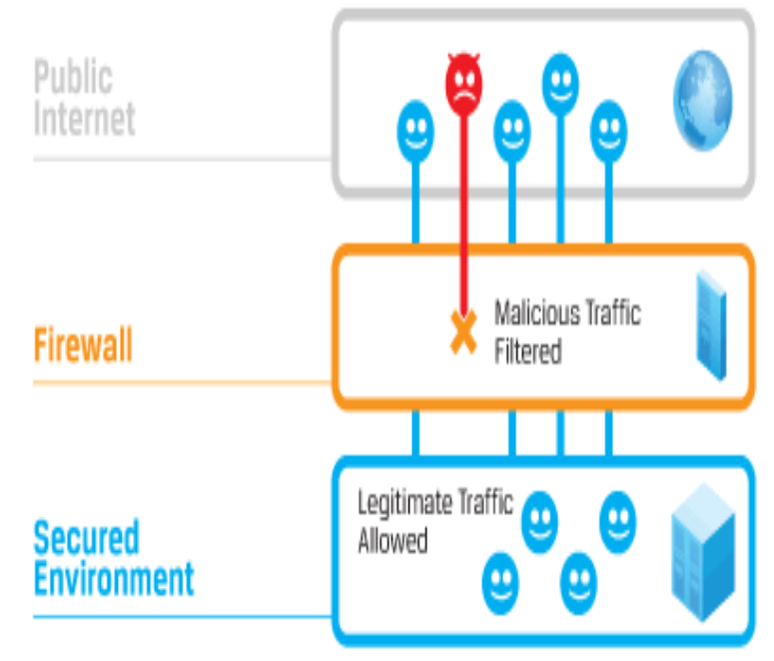
Types of Firewalls
Network layer firewalls (Packet Filters)
Make their decisions based on the source address, destination address and ports in individual IP packets.
A simple router is the traditional network layer firewall: not able to make particularly complicated decisions about what a packet is actually talking to or where it actually came from.

Slide 5
“Stateful”
“Stateful” firewall
A capability of a packet filtering firewall
Keep track of TCP sessions that are currently active
More properly refers to filtering rules rather than the firewall itself
Only TCP maintains state (3-way handshake)
IP, UDP, ICMP are stateless (every packet is independent)

Slide 6
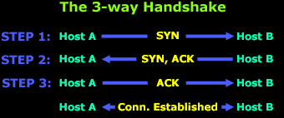
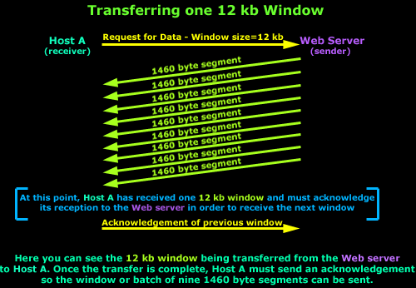
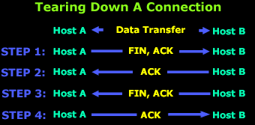
Background: TCP
http://www.firewall.cx/networking-topics/protocols/tcp/136-tcp-flag-options.html
http://www.firewall.cx/networking-topics/protocols/tcp/137-tcp-window-size-checksum.html

Slide 7
Access Control Lists (ACLs)
Access Control Lists (ACLs) can be set up on routers and servers to accept or deny packets from particular addresses or services.
Security policy: packet filter will either
Deny specific types of packets and accept all else
requires a thorough understanding of specific security threats
can be hard to implement
Accept specific types of packets and deny all else
does not have to predict future attacks
requires a good understanding of network requirements

Slide 8
ACL
Firewall rule lists are usually examined from the top of the list, down through to the bottom.
Firewall will look at the first rule, see if anything matches in that particular rule. If it doesn’t, it goes to the next rule and see if that rule matches the traffic, and so on.
On most firewalls, at the bottom of the list is an “implicit deny”. This means that if the traffic coming through the firewall doesn’t match any of the rules above, it is dropped by the firewall.

Slide 9
TCP Wrapper
In general terms, a TCP wrapped service is one that has been compiled with the libwrap library
These typically include sshd, sendmail, xinetd, etc.
When a connection attempt is made the service checks if connection is allowed based on rules in /etc/hosts.allow and /etc/hosts.deny
If no rules for the service are found in either file, or if neither file exists, access to the service is granted.
Changes to the hosts.allow and hosts.deny are dynamic: they take effect as soon as the file is saved.

Slide 10
TCP Wrapper - Examples
ALL : .example.com EXCEPT cracker.example.com
If this rule appears in /etc/hosts.allow, all example.com hosts are allowed to connect to all services except cracker.example.com
If this rule appears in /etc/hosts.deny, only cracker.example.com has access to all services, and other example.com hosts have access to none
So, what is the effect of this?
ALL EXCEPT telnetd : 192.168.0.
Only specifically allowed
Only specifically denied
hosts.deny can simply specify
ALL:ALL
With all specific rules in hosts.allow
blocked unless explicitly allowed is also called Implicit deny

Slide 11
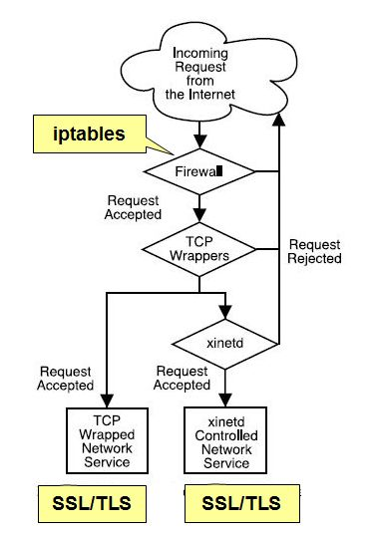
IPtables or TCPwrap ?
TCPwrap is simpler, rules take effect immediately, can use domain names
IPtables is faster, but rules are more difficult to write and require restart, limited to layers 3 and 4
No need for redundant rules
Lots of ways to divide things up
Need to use the logfiles over time to see traffic patterns and make informed decisions

Slide 12




Slide 13
DMZ
Internet Service Provider
Enterprise
Network
ACLs on router and individual servers
Web, File, DNS, Mail Servers
DMZ: demilitarized zone
(uncontrolled access)
Internet Service Provider
Enterprise
Network
“Militarized”: Every access is examined and logged
ACLs on dedicated firewall or “Bastion Host”
Web, File, DNS, Mail Servers
Notes:
13

Slide 14

IDS: Intrusion Detection System
Gathers and analyzes information from within a computer or a network to identify the possible violations of security policy, including unauthorized access and misuse
The ultimate aim is to catch perpetrators before they do real damage to your resources
Based on your security policy and administrator intuition and experience
Uses:
Rogue system detection.
Reconnaissance identification.
Attack pattern identification.

Slide 15
Types of IDS
Network-Based Intrusion Detection
Listening for patterns indicative of an intrusion
Log File Monitoring
Programs that parse log files after an event has already occurred, eg. Failed log in attempts
File Integrity Checking
Check files been modified indicating an intruder has already been there

Slide 16





IDS vs. Firewall
Firewall directly allows or denies access to services based on network and transport layer header information in individual packets such as address, service, and direction of the packet.
Network IDS analyses sets of packets (traffic patterns) to determine misuse (malicious or abusive activity inside the network) or intrusion (from the outside).
When something suspicious has been identified it signals an alarm
Possible SYN flood!

Slide 17
ACLs on router and individual servers
DMZ: demilitarized zone
(uncontrolled access)
DMZ
Internet Service Provider
Enterprise
Network
Web, File, DNS, Mail Servers
IDS Inside:
Catches what was missed by the Firewall
IDS Outside:
Catches everything the world throws at you – Good for research
Notes:
17

Slide 18
False Positives are an issue with IDS
False Positive
Something incorrectly identified as a vulnerability.
Normal activity identified as malicious
Annoying, but no security breach
Impact is Opposite of Biometric Systems!
False Negative
Impact is Opposite of Biometric Systems!
Something incorrectly identified as secure.
Malicious activity identified as normal
Security Breach – Mission Failure!

Slide 19

Intrusion Prevention System (IPS)
A system that performs the functions of an IDS but that can also take action (like a firewall) to block threats.
Configure the threats that should be handled automatically.
Passive response still implemented for other incidents.
Useful, but with some pitfalls:
False positives may lead to the blocking of legitimate behavior.
False negatives may lull you into a false sense of security.
A well-managed and finely tuned IPS is a powerful defense option.
Possible SYN flood!
Traffic dropped!

